Slide 1
MAJOR PROJECT ON
BANKING

Slide 2
HEADER FILES USED AND THEIR PURPOSE
FSTREAM.H – for file handling, cin and cout
PROCESS.H – for exit() function
CONIO.H – for clrscr() and getch() functions
STDIO.H – for standard I/O operations
DOS.H – for execution of program
STRING.H – for string handling
GRAPHICS.H – for graphical display
IOMANIP.H–for C++ streams I/O manipulators

Slide 3
FILES GENERATED
DATA FILES
BANK.DAT
PROGRAM FILE
BANK.CPP
OBJECT FILE
BANK.OBJ
EXECUTION FILE
BANK.EXE

Slide 4
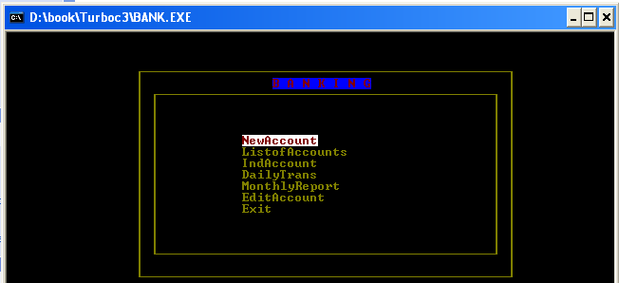
PROGRAM OUTPUT:

Slide 5
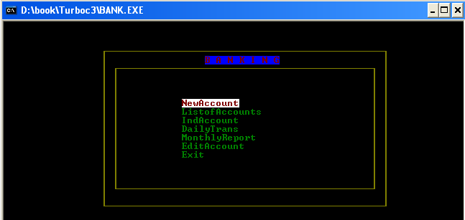
When enter our choice : NEW ACCOUNT

Slide 6
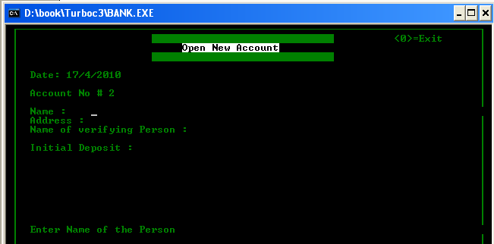
Output obtained by choosing the first option is to open the new account in bank.

Slide 7
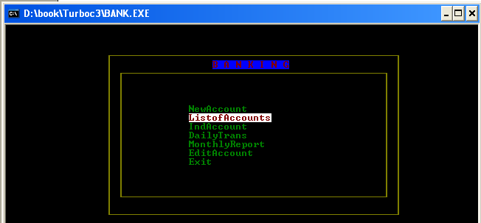
When enter our choice : LIST OF ALL ACCOUNTS

Slide 8
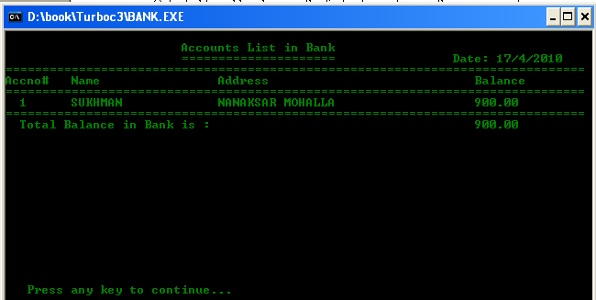
Output obtained by choosing the second option see all accounts list.

Slide 9
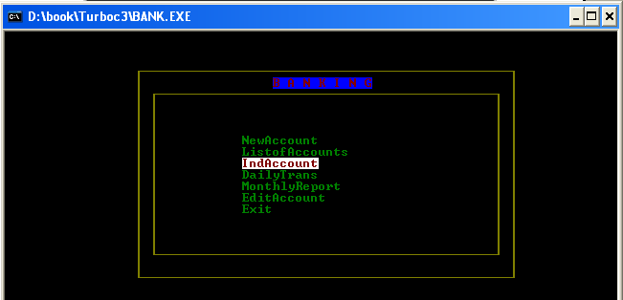
When enter our choice : SEE ALL TRANSACTION OF ACCOUNT

Slide 10
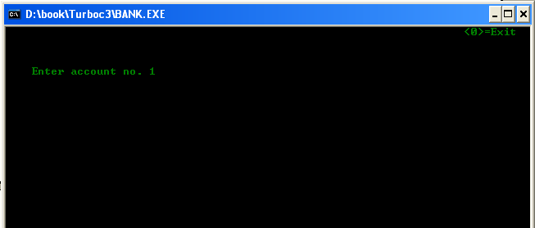
When we enter third option indAccount then following window will be displayed.

Slide 11
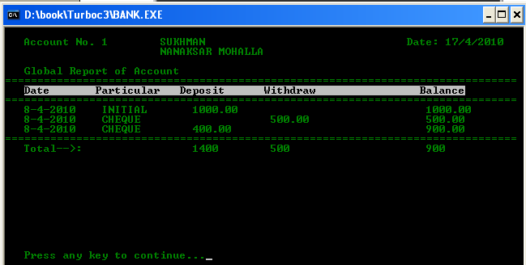
After enter the account number :- 1 the OUTPUT is

Slide 12
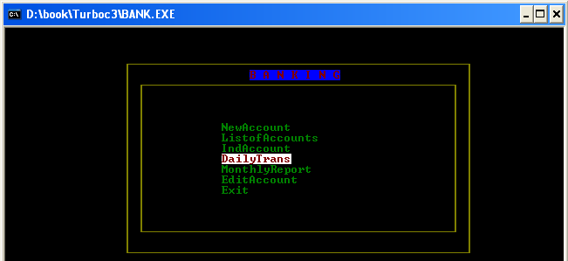
When enter our choice : DAILY TRANSACTION

Slide 13
Output obtained by choosing the FOURTH option then enter the account number.

Slide 14
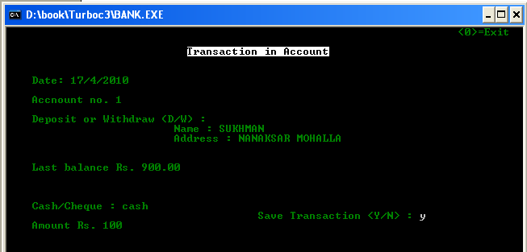
After enter the account number :-1 , enter the transaction of deposit or withdraw in account then enter the amount in cash or cheque last option enter the amount in rupees and then save the transaction yes or no.

Slide 15
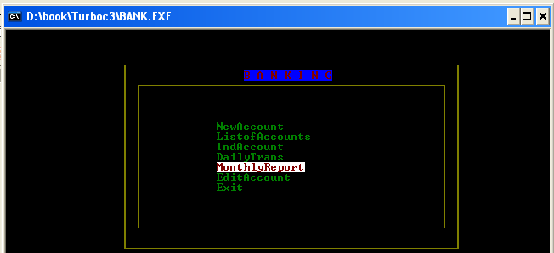
When enter our choice : MONTHLY REPORT

Slide 16
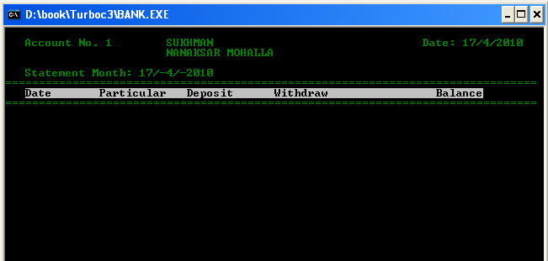
Output obtained by choosing the FIVTH option is show the all monthly report of account.

Slide 17
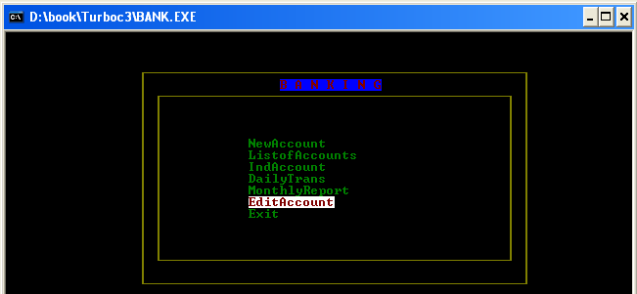
When enter our choice : EDIT ACCOUNT

Slide 18
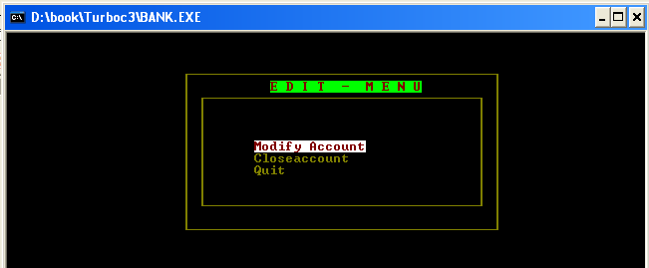
Output obtained by choosing the SIXTH option is modify the account and close the account and quit is used for exit from the edit menu.

Slide 19
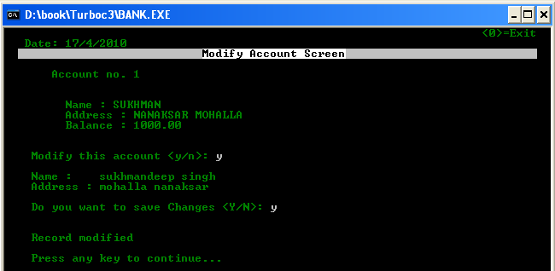
When enter the Modify account ,first enter the account number then enter the modify this account yes or no.

Slide 20
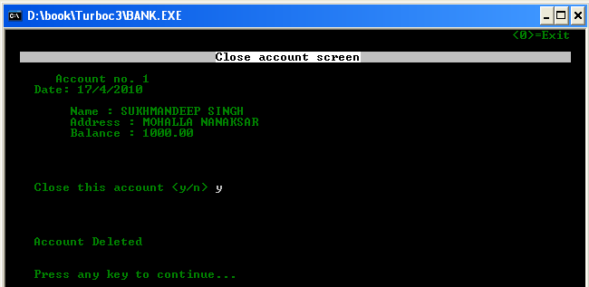
When enter the close account, first enter the account number and then delete the account yes or no.

Slide 21
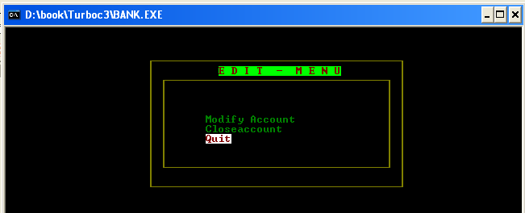
When press the quit ,then exit from the edit menu.

Slide 22
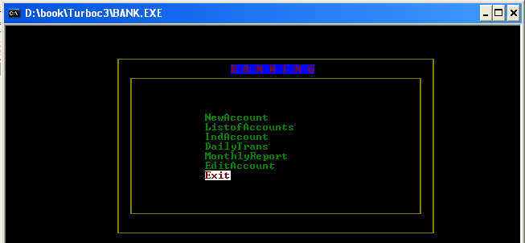
When enter our choice : EXIT
Then exit from the banking project

